Slide 1
SNS ACADEMY
A fingerprint International School
Affiliated to CBSE New Delhi
Affiliation No :1930610
GRADE : 8 (2022-23)
COURSE NAME : SOCIAL SCIENCE
Chapter-6
History
THE GREAT UPRISING

Slide 2
THE GREAT UPRISING
1857

Slide 4
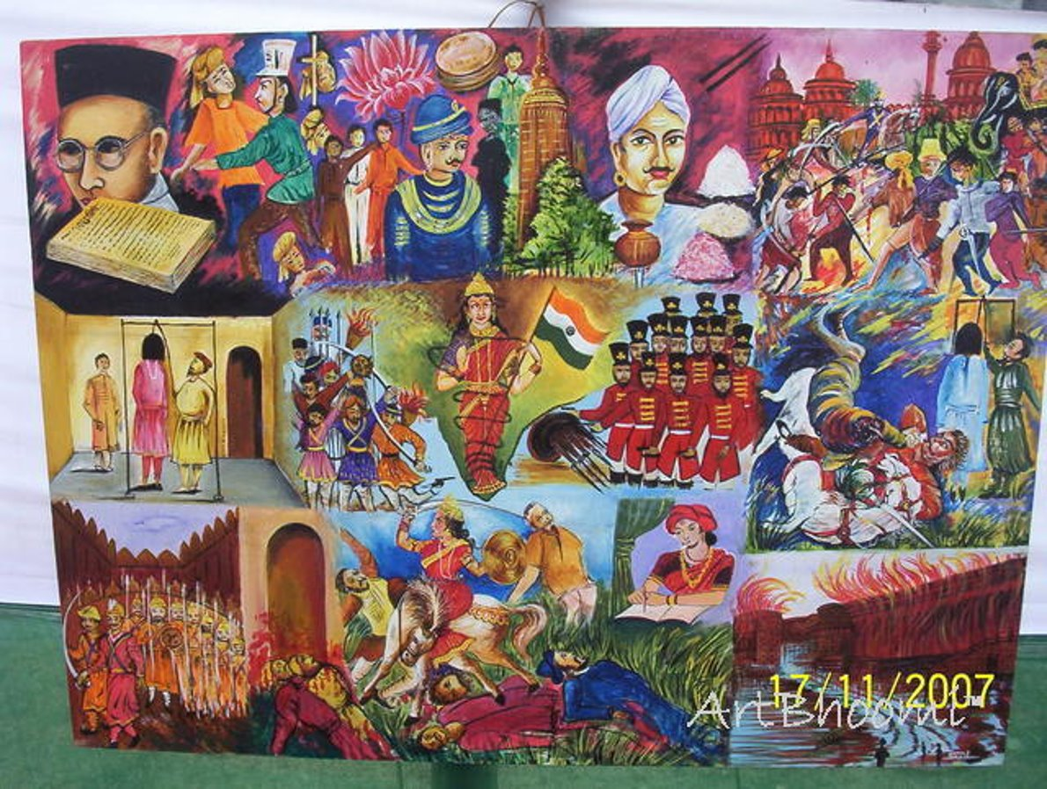

Slide 5
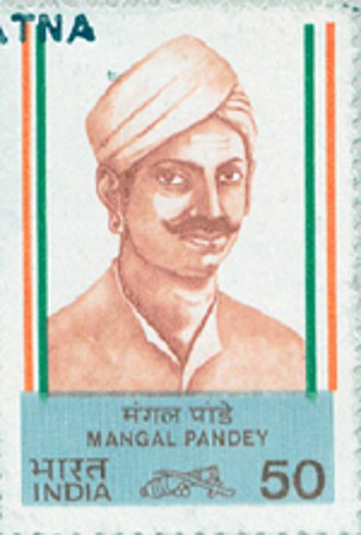

Slide 6
https://www.powershow.com/view/41b03d-NjNjN/THE_REVOLT_OF_1857_powerpoint_ppt_presentation

